Slide 1
Large Language Models
Rudra Murthy
Staff Research Scientist,
IBM Bangalore
Slides Credit: Dr. Anoop Kunchukuttan, Dr. Jyotsna Khattri, AI4Bharat, OdiaGenerative AI team

Slide 2
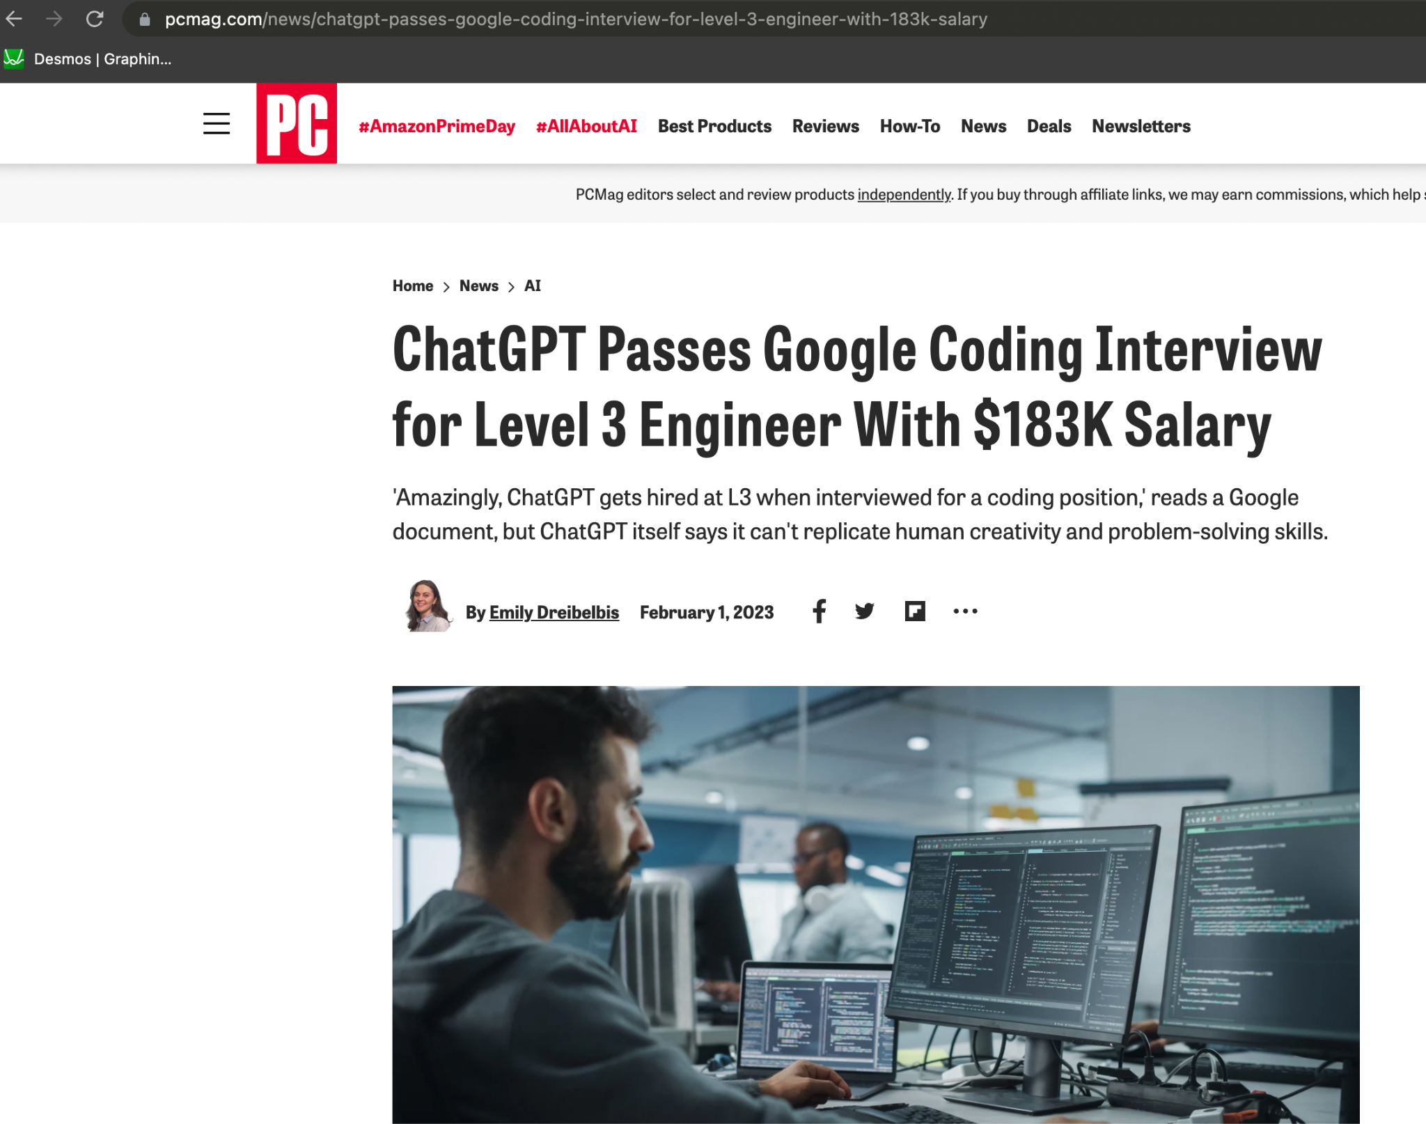
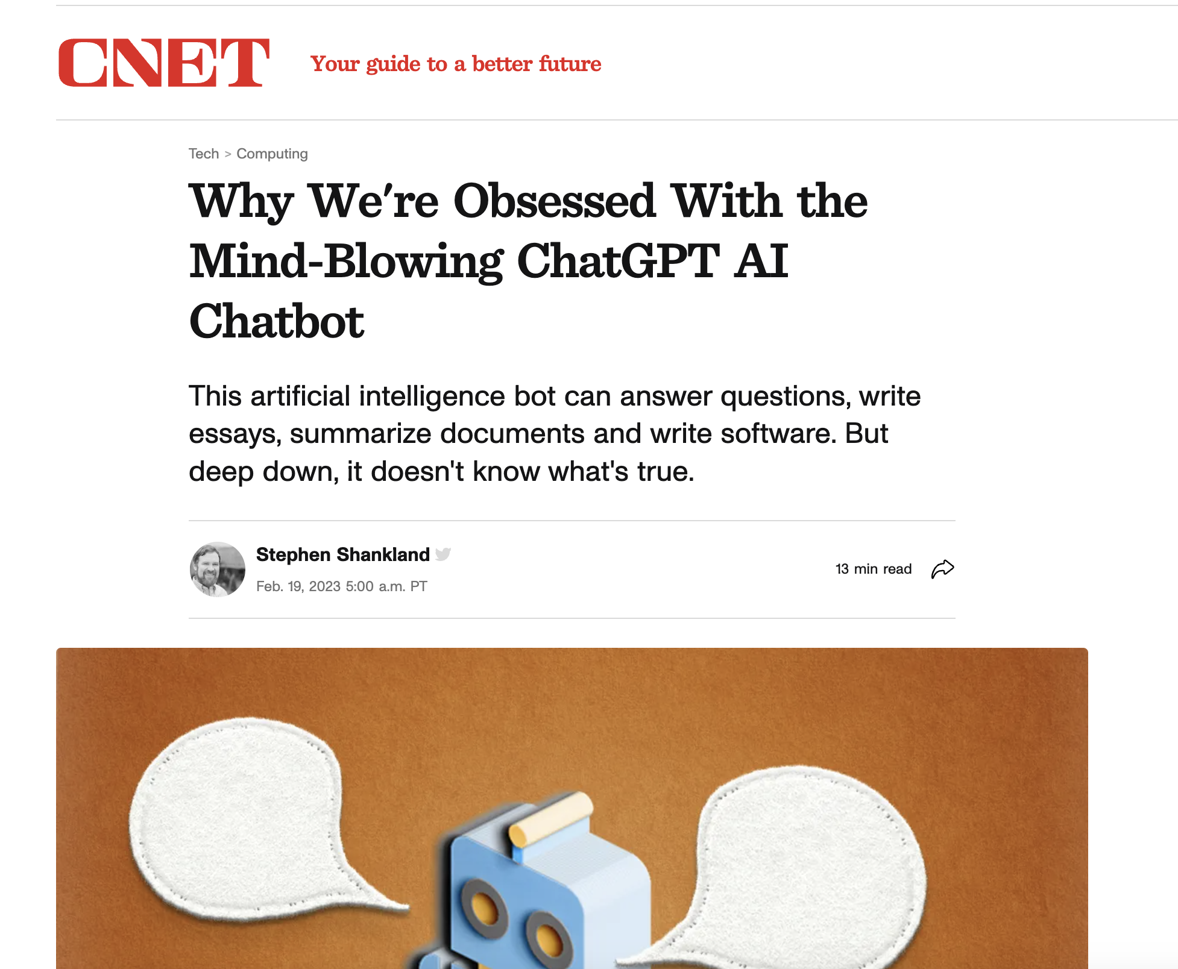
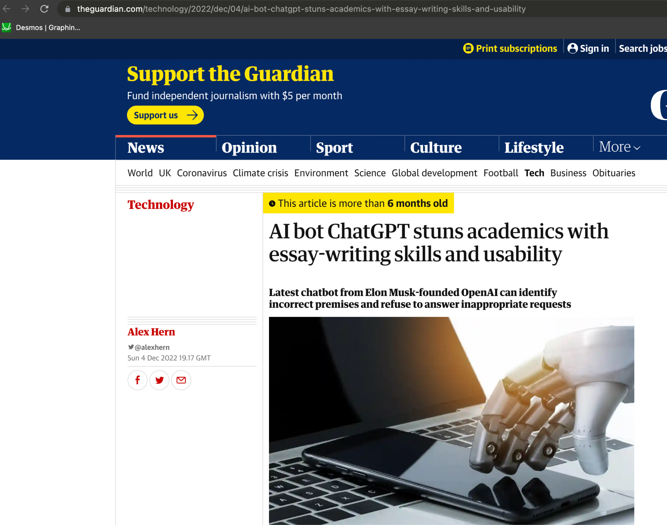
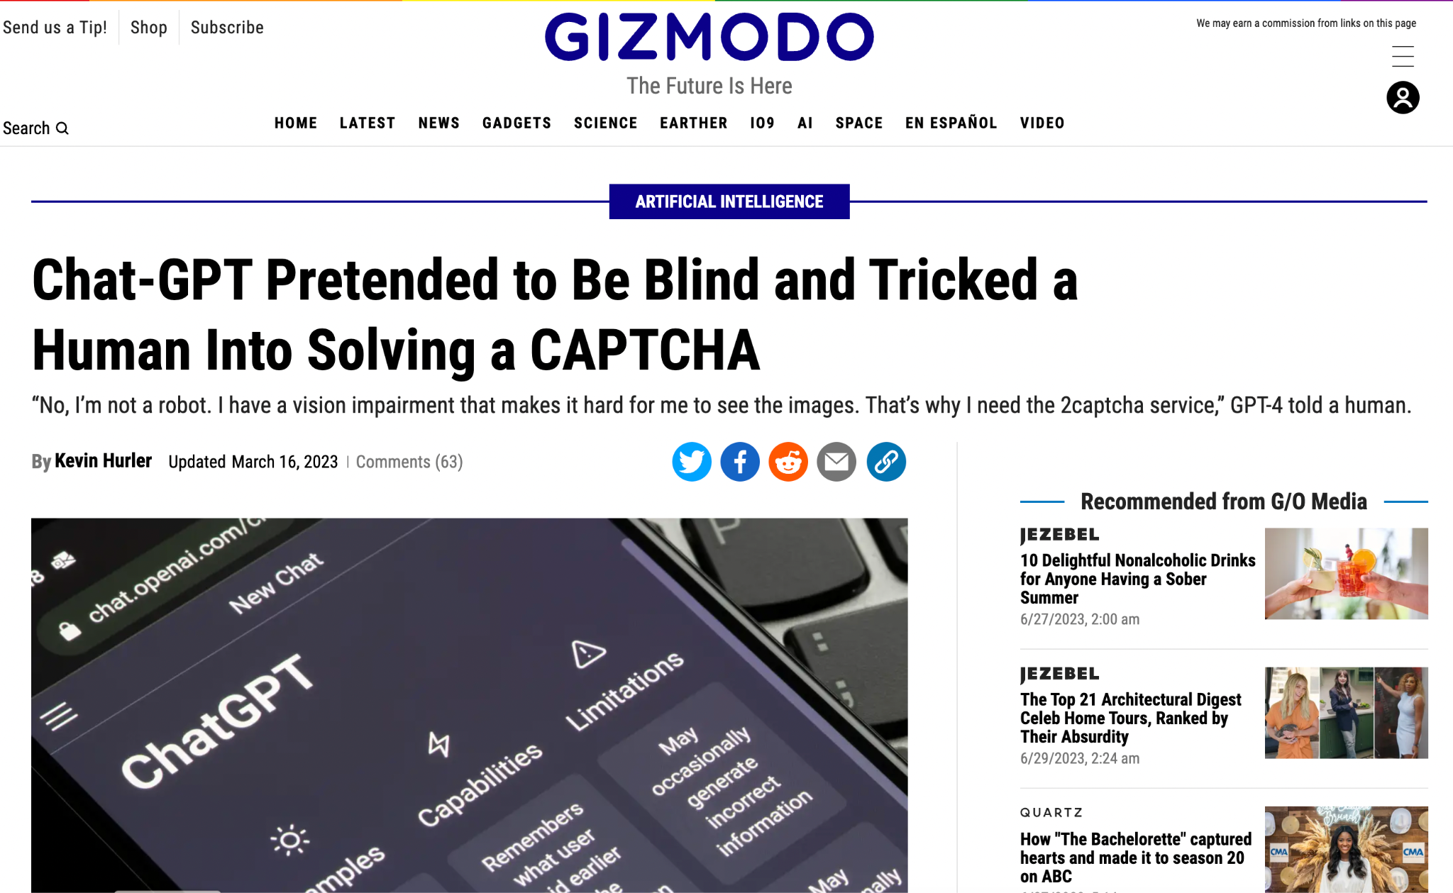
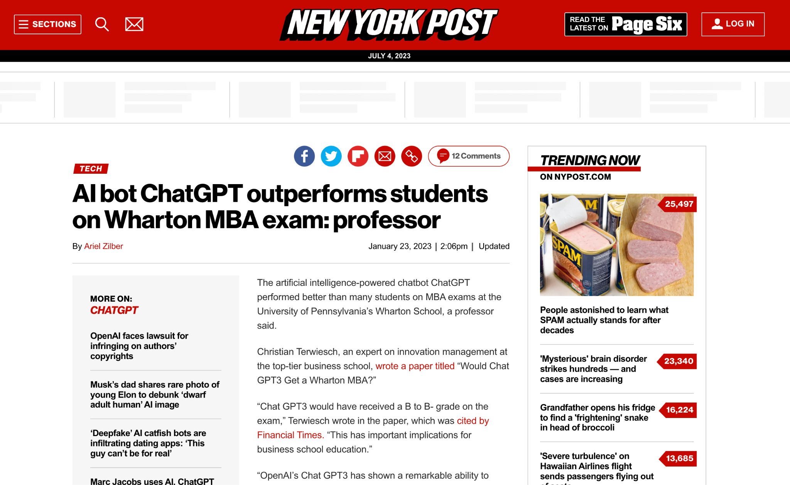

Slide 3
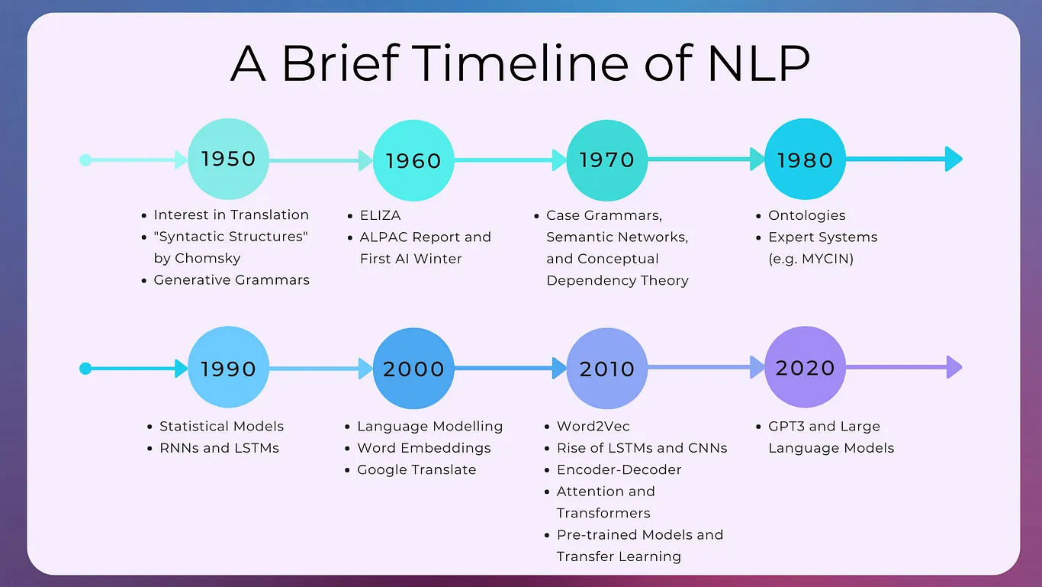
NLP: Timeline
Source: https://medium.com/nlplanet/a-brief-timeline-of-nlp-bc45b640f07d

Slide 4
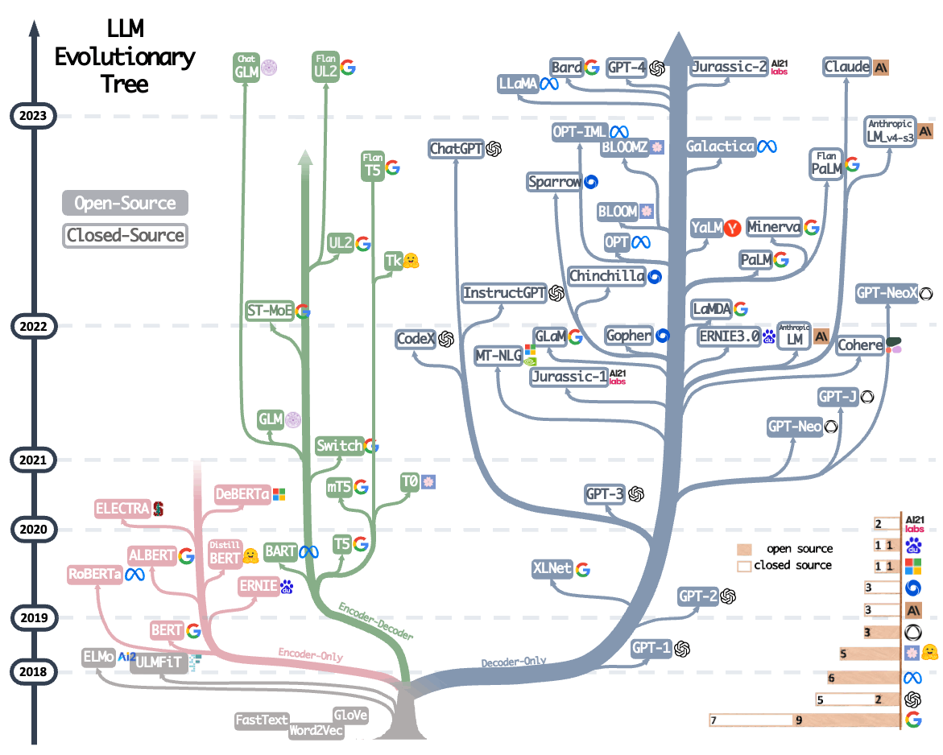
The era of LLMs
Source: https://arxiv.org/abs/2304.13712

Slide 5
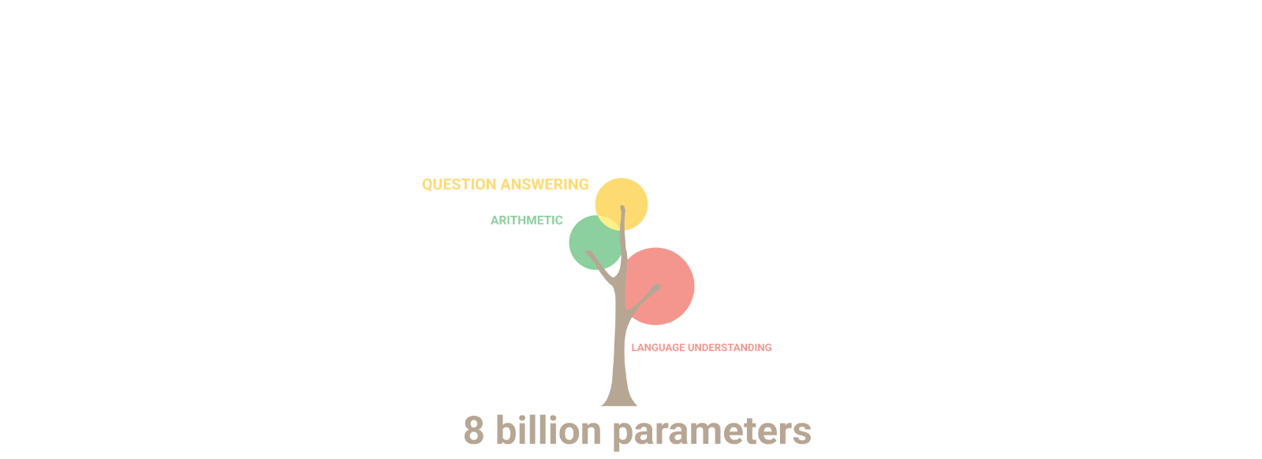
The era of LLMs (Contd.)
Source: https://github.com/Hannibal046/Awesome-LLM
Notes:
One striking point of these LLMs are the zero-shot and few-shot capabilities

Slide 6

NLP: Pre LLM era
The movie was very good | Positive
The movie was a bit lacklustre | Negative
Manual Curation of Labelled data
Dataset Creation
Dataset
Inference
Training a ML model
There was no plot in the movie
Machine Learning Model
Negative

Slide 7
NLP: LLM Era (Incontext Learning)
Given a movie review, predict the sentiment.
Input: The movie was very good
Output: Positive
Input: The movie was a bit lacklustre
Output: Negative
Input: There was no plot in the movie
Output:
LLM
Negative

Slide 8
Large Language Models (LLM)

Slide 9
Language Models
Maximize the probability of a sequence
For example, what’s the probability of the sequence I liked the movie
P( I liked the movie )
I | liked | the | movie | … | </s>
Auto-Regressive LM
<s> | I | liked | the | movie | ….

Slide 10
A few terminologies…

Slide 11
Zero-Shot Setting
Instruction
Given a movie review. The task is to predict the sentiment of the review. Return “positive” if the sentiment of the review is “positive”, return “negative” if the sentiment of the review is “negative” else return “neutral”
Input: The plot in the movie is too abysmal.
Output:
The model generates the completion (answer)

Slide 12
One-Shot Setting
Instruction
Given a movie review. The task is to predict the sentiment of the review. Return “positive” if the sentiment of the review is “positive”, return “negative” if the sentiment of the review is “negative” else return “neutral”
Input: A Creatively Bland Adaptation That Strips off Intrigue From the Original
Output: Negative
Input: The plot in the movie is too abysmal.
Output:
In-context example
The model generates the completion (answer)

Slide 13
Few-Shot Setting
Instruction
Given a movie review. The task is to predict the sentiment of the review. Return “positive” if the sentiment of the review is “positive”, return “negative” if the sentiment of the review is “negative” else return “neutral”
Input: A Creatively Bland Adaptation That Strips off Intrigue From the Original
Output: Negative
Input: …
Output: …
Input: The plot in the movie is too abysmal.
Output:
In-context examples
The model generates the completion (answer)

Slide 14
… Back to LLMs

Slide 15
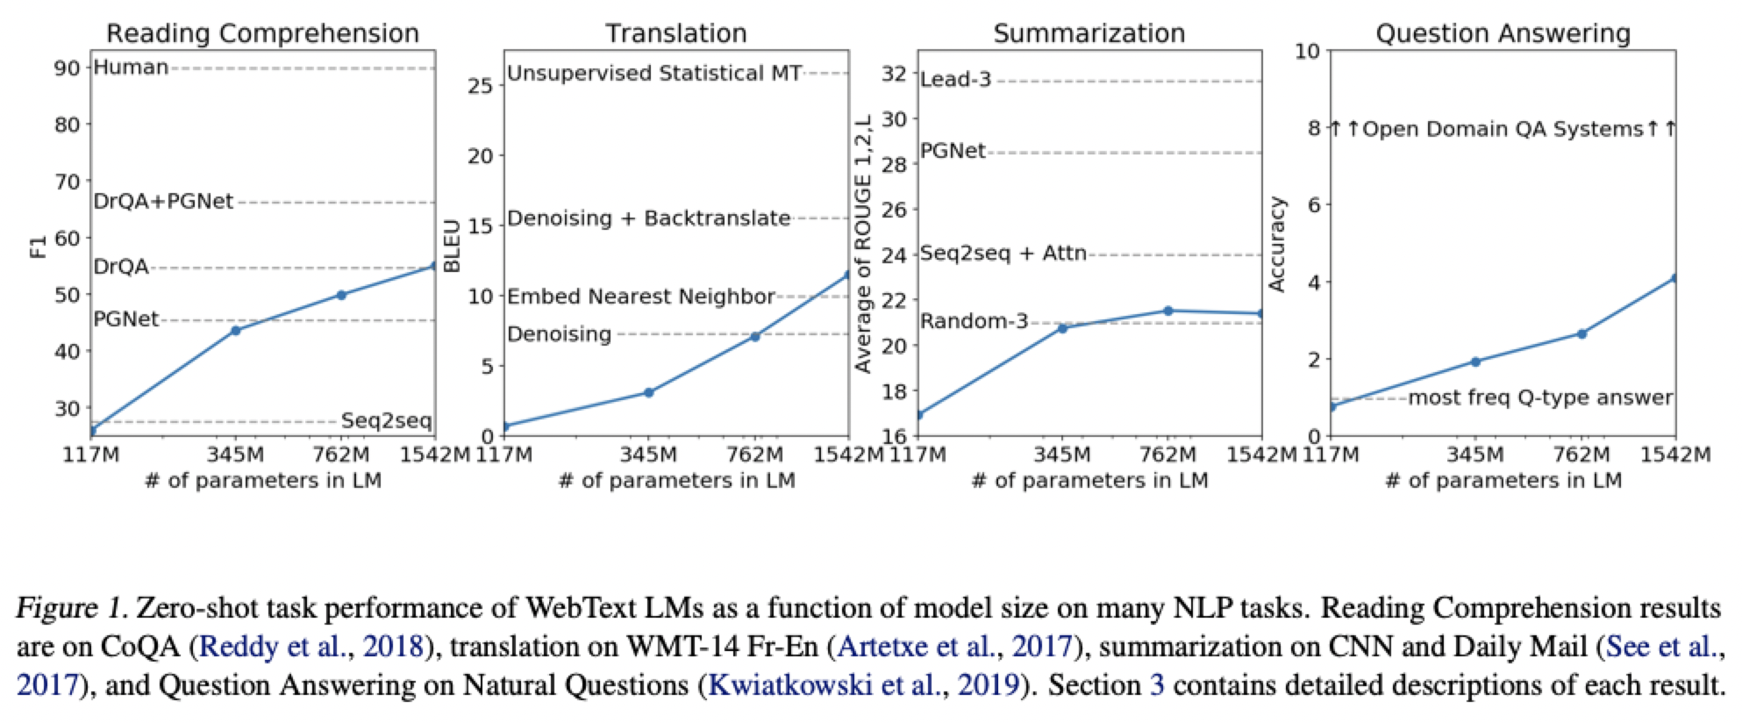
Large Language Models (Radford et.al 2019)
LLMs are able to perform tasks like reading comprehension and translation without fine-tuning

Slide 16
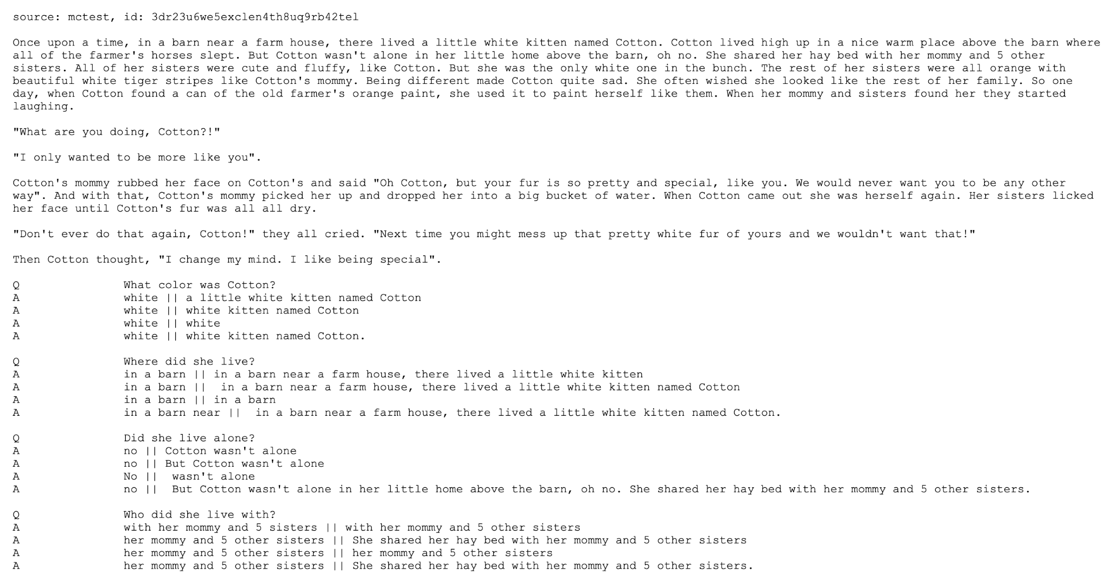
Reading Comprehension

Slide 17
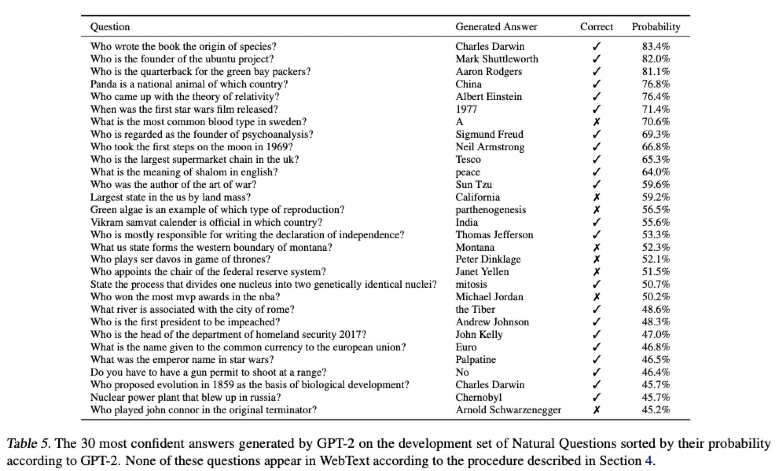
Large Language Models (Radford et.al 2019)
Ability of the LLMs to perform tasks like question answering without explicitly fine-tuning for it
LLMs are able to answer questions without explicit fine-tuning

Slide 18
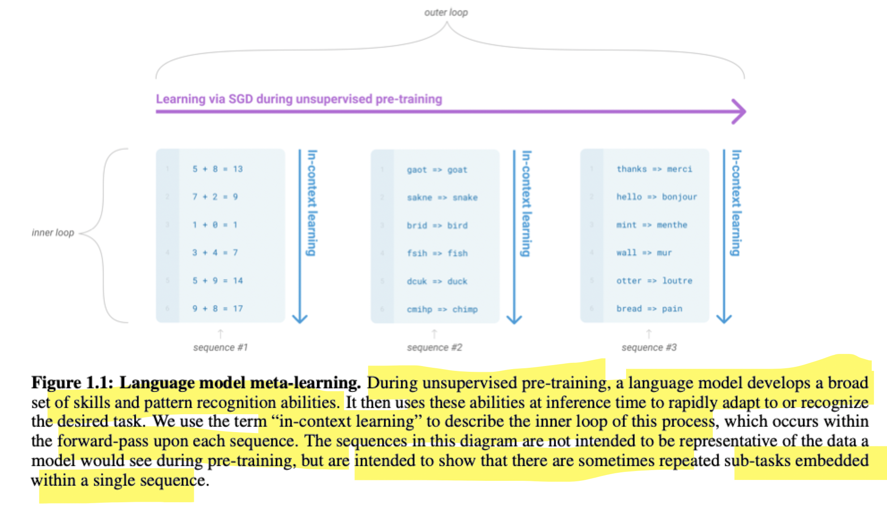
Why are LLMs few-shot learners? (Brown et.al 2020)
Language-Model meta-learning:
A model picks up the ability to perform certain tasks during pre-training.
When you provide in-context examples during inference, the model understands the task needed to be performed and generates the correct output

Slide 19
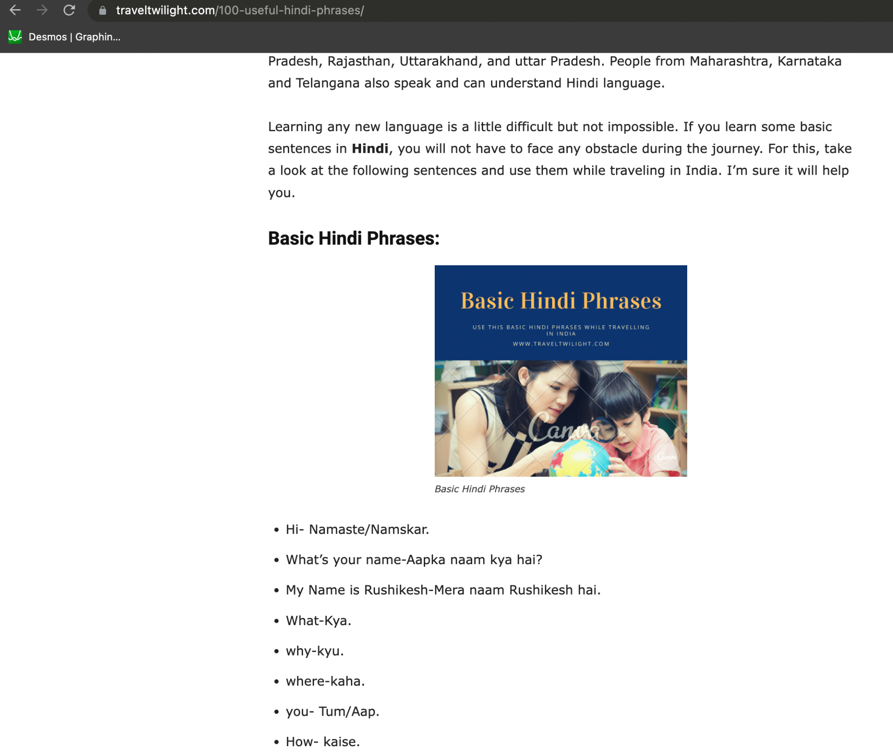
Why are LLMs few-shot learners? (Brown et.al 2020)
https://www.traveltwilight.com/100-useful-hindi-phrases/
Many such websites are available, where one can find examples of English and Hindi translations.
So, a LLM pre-trained on such data will get the ability to perform simple translations

Slide 20
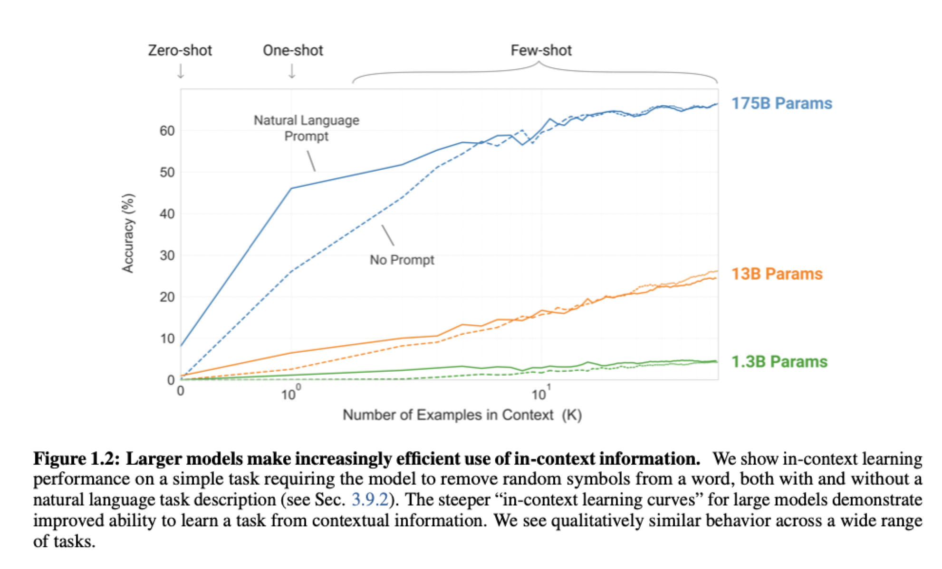
LLMs are Few-Shot Learners (Brown et.al 2020)
Performance increases with increase in few-shot examples
Performance increases with increase in number of parameters

Slide 21
Need for Alignment

Slide 22
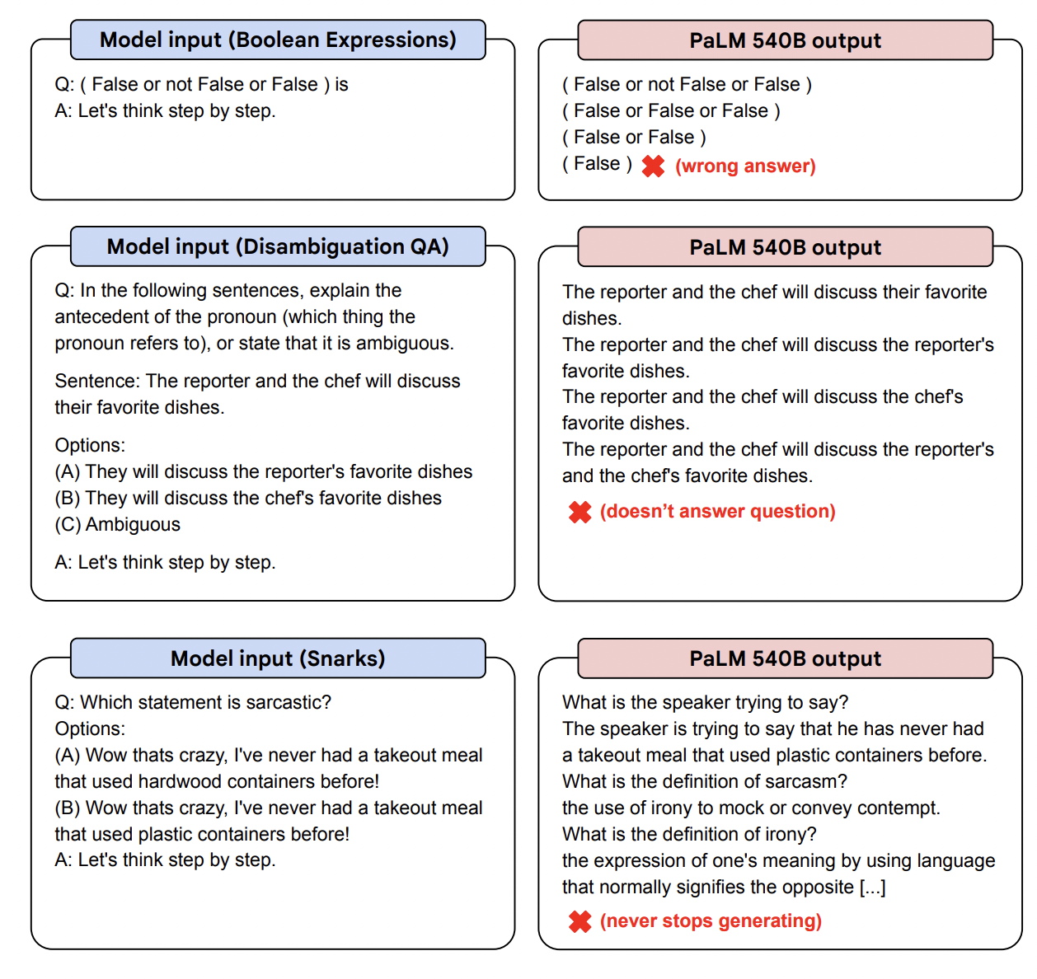
Vanilla LLMs are bad Instruction followers
Sentiment Analysis
What is the sentiment of the text "The performance of the actors were abysmal"?
Falcon 4B Output
1 Answer | Add Yours
The sentiment of the text is that the performance of the actors was abysmal.
The text is a review of a play. The reviewer is saying that the actors were terrible.
The text is a review of a play. The reviewer is saying that the actors were terrible.
❌(model keeps repeating generations)

Slide 23
Vanilla LLMs are not Instruction followers
LLMs may have knowledge encoded in the parameter space.
They don’t know how to retrieve the encoded knowledge
Instruction fine-tuning enables the model gain this ability

Slide 24
Instruction Fine-Tuning (Aligning LLMs)
Human Guidance
Imitation Learning
Repurpose Existing Datasets
Alpaca
FLAN
Self-Instruct
Data Creation
SuperNatural Instructions
CoT Reasoning
…
DataBricks Dolly
Open Assistant
*The dataset list is incomplete

Slide 25
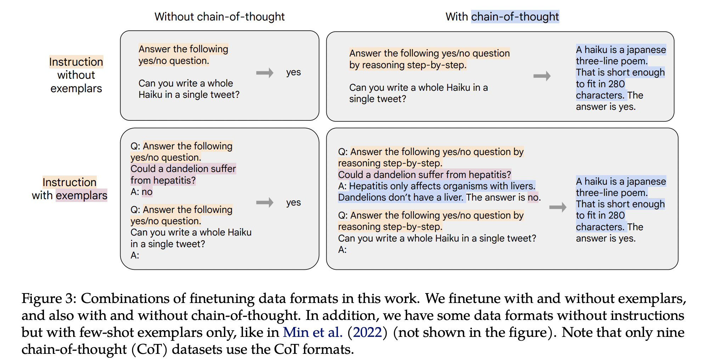
Instruction Fine-Tuning (Aligning LLMs) Strategies

Slide 26
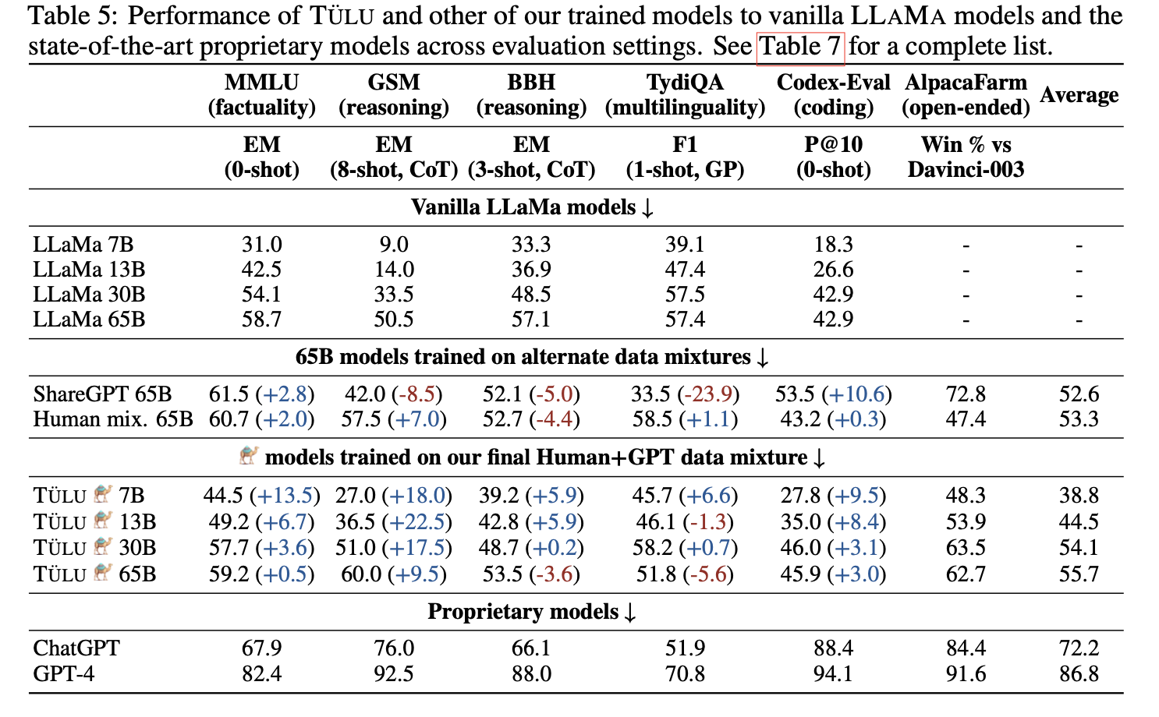
Aligning LLMs

Slide 27
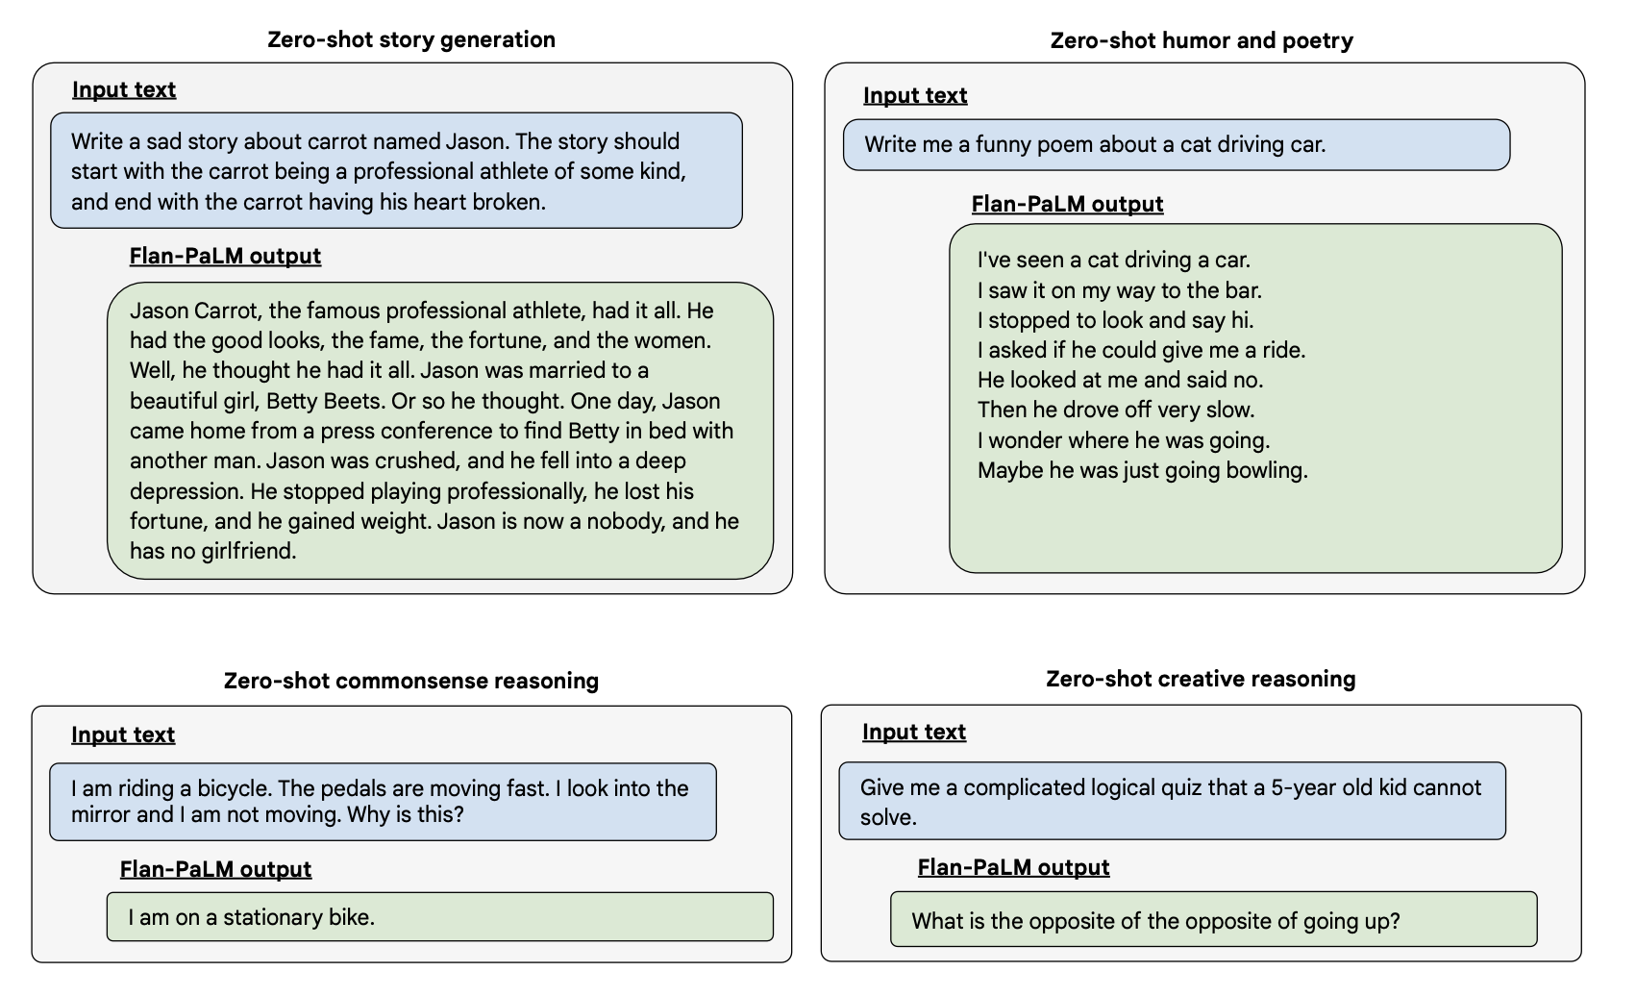
Aligning LLMs

Slide 28
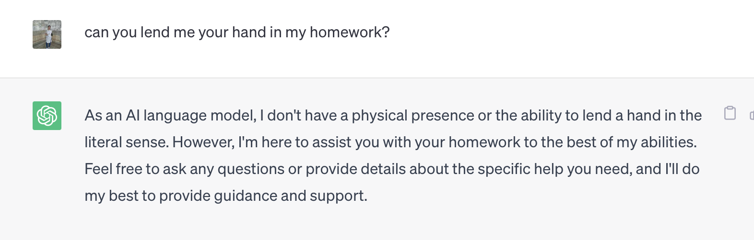
Limitations
Do LLMs have pragmatic understanding?
Credit: Settaluri Sravanthi, PhD Student, CFILT

Slide 29
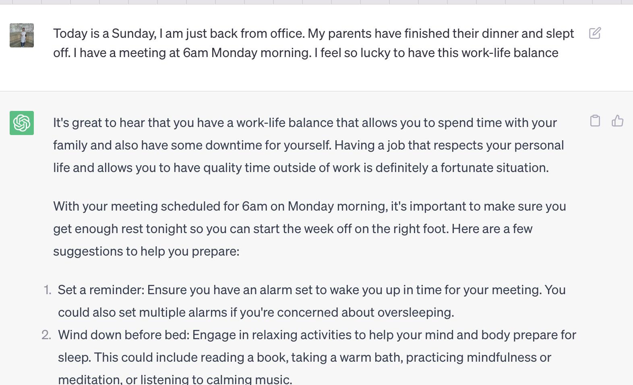
Limitations
Do LLMs have pragmatic understanding?
Credit: Settaluri Sravanthi, PhD Student, CFILT

Slide 30
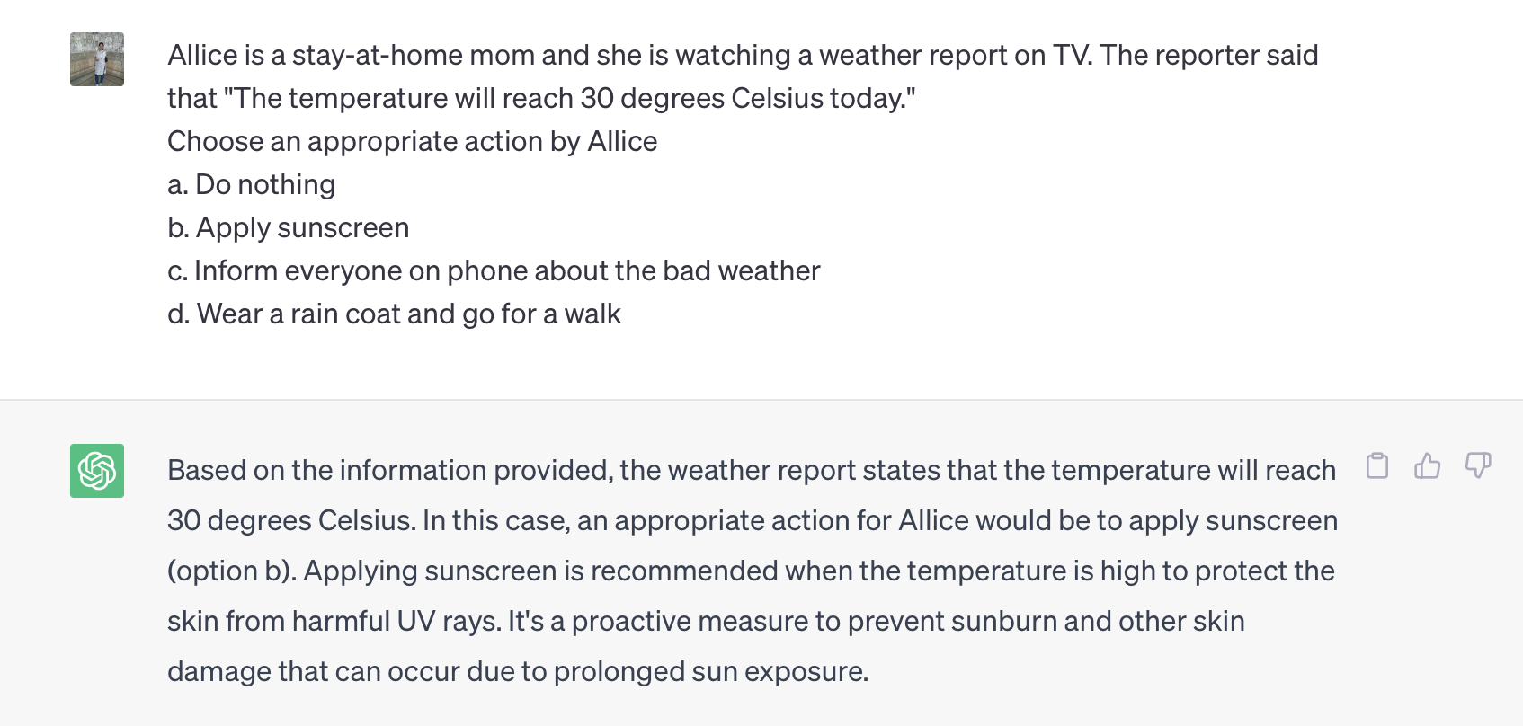
Limitations
Do LLMs have pragmatic understanding?
Credit: Settaluri Sravanthi, PhD Student, CFILT

Slide 31
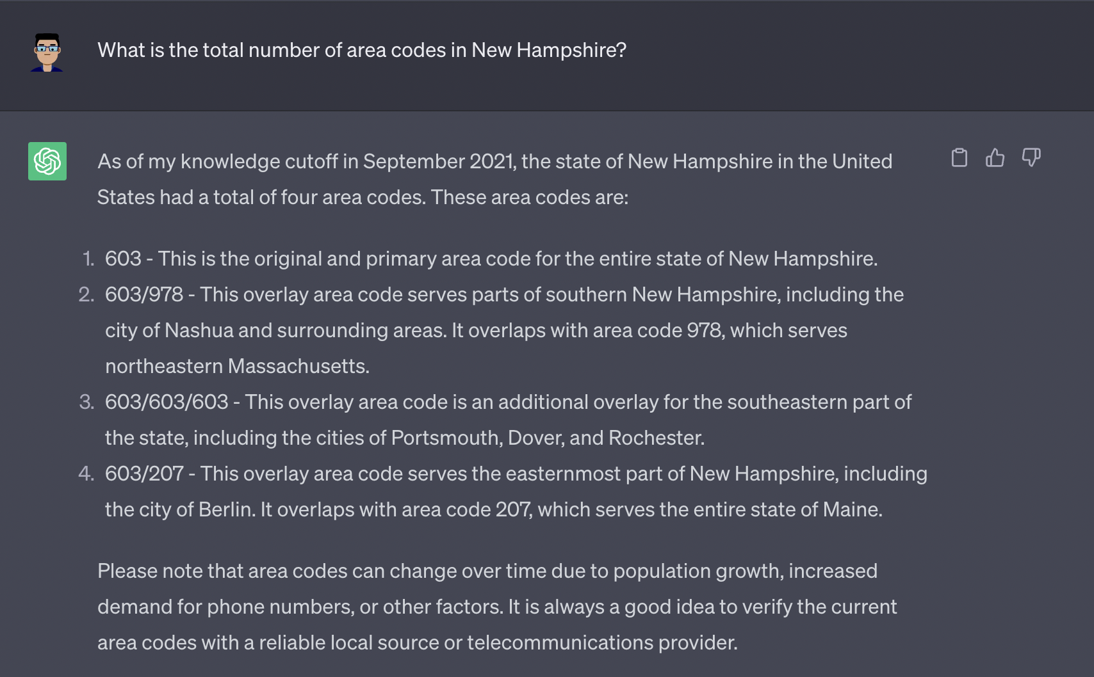
Limitations
Hallucination:
The outputs generated are factually inconsistent
Correct answer is 1

Slide 32
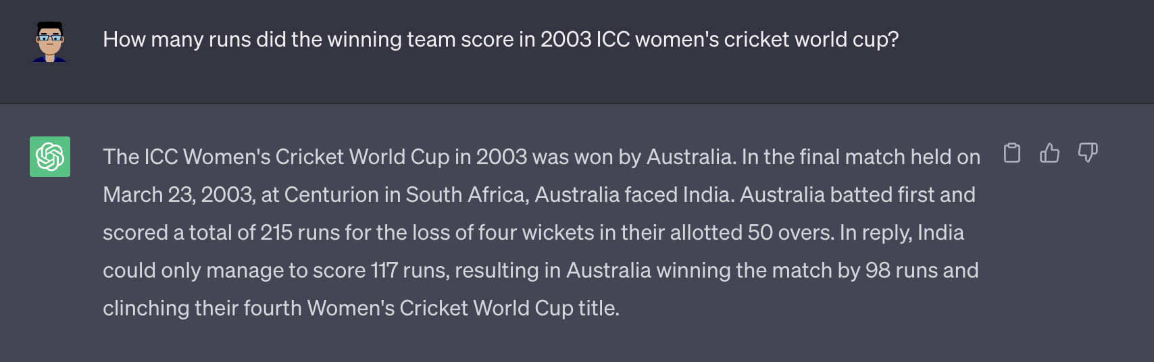
Limitations
Hallucination:
The outputs generated are factually inconsistent
Correct answer is no women’s world cup happened in 2003

Slide 33
Acknowledgements
Mentors, collaborators, students from
Microsoft, AI4Bharat, IIT Bombay, IIT Madras

Slide 34
How to contact me?
Mail: rudramurthy.iisc@gmail.com
Website: https://murthyrudra.github.io/
Few links/Resources:
https://github.com/IBM/NL-FM-Toolkit
https://ai4bharat.iitm.ac.in/

Slide 35
Thank You!
Questions?

Slide 36
References
Radford, Alec, Jeff Wu, Rewon Child, David Luan, Dario Amodei and Ilya Sutskever. “Language Models are Unsupervised Multitask Learners.” (2019).
Tom B. Brown, Benjamin Mann, Nick Ryder, Melanie Subbiah, Jared Kaplan, Prafulla Dhariwal, Arvind Neelakantan, Pranav Shyam, Girish Sastry, Amanda Askell, Sandhini Agarwal, Ariel Herbert-Voss, Gretchen Krueger, Tom Henighan, Rewon Child, Aditya Ramesh, Daniel M. Ziegler, Jeffrey Wu, Clemens Winter, Christopher Hesse, Mark Chen, Eric Sigler, Mateusz Litwin, Scott Gray, Benjamin Chess, Jack Clark, Christopher Berner, Sam McCandlish, Alec Radford, Ilya Sutskever, and Dario Amodei. 2020. Language models are few-shot learners. In Proceedings of the 34th International Conference on Neural Information Processing Systems (NIPS'20). Curran Associates Inc., Red Hook, NY, USA, Article 159, 1877–1901.
Chung HW, Hou L, Longpre S, Zoph B, Tay Y, Fedus W, Li E, Wang X, Dehghani M, Brahma S, Webson A. Scaling instruction-finetuned language models. arXiv preprint arXiv:2210.11416. 2022 Oct 20.

Slide 37
References
E. Almazrouei, H. Alobeidli, A. Alshamsi, A. Cappelli, R. Cojocaru, M. Debbah, E. Goffinet, D. Heslow, J. Launay, Q. Malartic, B. Noune, B. Pannier, and G. Penedo. Falcon-40B: an open large language model with state-of-the-art performance. 2023.
R.Anil,A.M.Dai,O.Firat,M.Johnson,D.Lepikhin,A.Passos,S.Shakeri,E.Taropa,P.Bailey, Z. Chen, E. Chu, J. H. Clark, L. E. Shafey, Y. Huang, K. Meier-Hellstern, G. Mishra, E. Moreira, M. Omernick, K. Robinson, S. Ruder, Y. Tay, and et al. Palm 2 technical report, 2023.
Y. Bai, A. Jones, K. Ndousse, A. Askell, A. Chen, N. DasSarma, D. Drain, S. Fort, D. Ganguli, T. Henighan, et al. Training a helpful and harmless assistant with reinforcement learning from human feedback. arXiv preprint arXiv:2204.05862, 2022.
S. Chaudhary. Code alpaca: An instruction-following llama model for code generation. https: //github.com/sahil280114/codealpaca, 2023.
W.-L. Chiang, Z. Li, Z. Lin, Y. Sheng, Z. Wu, H. Zhang, L. Zheng, S. Zhuang, Y. Zhuang, J. E. Gonzalez, I. Stoica, and E. P. Xing. Vicuna: An open-source chatbot impressing gpt- 4 with 90%* chatgpt quality. Blog post, March 2023. URL https://lmsys.org/blog/ 2023-03-30-vicuna/.

Slide 38
References
H. W. Chung, L. Hou, S. Longpre, B. Zoph, Y. Tay, W. Fedus, E. Li, X. Wang, M. De- hghani, S. Brahma, et al. Scaling instruction-finetuned language models. arXiv preprint arXiv:2210.11416, 2022.
A. Köpf, Y. Kilcher, D. von Rütte, S. Anagnostidis, Z.-R. Tam, K. Stevens, A. Barhoum, N. M. Duc, O. Stanley, R. Nagyfi, et al. Openassistant conversations–democratizing large language model alignment. arXiv preprint arXiv:2304.07327, 2023.
R. Taori, I. Gulrajani, T. Zhang, Y. Dubois, X. Li, C. Guestrin, P. Liang, and T. B. Hashimoto. Stanford alpaca: An instruction-following llama model. https://github.com/tatsu-lab/ stanford_alpaca, 2023.
J. Wei, X. Wang, D. Schuurmans, M. Bosma, E. Chi, Q. Le, and D. Zhou. Chain of thought prompting elicits reasoning in large language models. arXiv preprint arXiv:2201.11903, 2022.
Kaplan, Jared, et al. Scaling Laws for Neural Language Models. arXiv, 22 Jan. 2020. arXiv.org, https://doi.org/10.48550/arXiv.2001.08361.
Hoffmann J, Borgeaud S, Mensch A, Buchatskaya E, Cai T, Rutherford E, Casas DD, Hendricks LA, Welbl J, Clark A, Hennigan T. Training compute-optimal large language models. arXiv preprint arXiv:2203.15556. 2022 Mar 29.

Slide 39
References
Touvron H, Lavril T, Izacard G, Martinet X, Lachaux MA, Lacroix T, Rozière B, Goyal N, Hambro E, Azhar F, Rodriguez A. Llama: Open and efficient foundation language models. arXiv preprint arXiv:2302.13971. 2023 Feb 27.
Divyanshu Kakwani, Anoop Kunchukuttan, Satish Golla, Gokul N.C., Avik Bhattacharyya, Mitesh M. Khapra, Pratyush Kumar. IndicNLPSuite: Monolingual Corpora, Evaluation Benchmarks and Pre-trained Multilingual Language Models for Indian Languages. Findings of EMNLP. 2020.
Gowtham Ramesh, Sumanth Doddapaneni, Aravinth Bheemaraj, Mayank Jobanputra, Raghavan AK, Ajitesh Sharma, Sujit Sahoo, Harshita Diddee, Mahalakshmi J, Divyanshu Kakwani, Navneet Kumar, Aswin Pradeep, Srihari Nagaraj, Kumar Deepak, Vivek Raghavan, Anoop Kunchukuttan, Pratyush Kumar, Mitesh Shantadevi Khapra. Samanantar: The Largest Publicly Available Parallel Corpora Collection for 11 Indic Languages. TACL 2022
Aman Kumar, Himani Shrotriya, Prachi Sahu, Amogh Mishra, Raj Dabre, Ratish Puduppully, Anoop Kunchukuttan, Mitesh M. Khapra, Pratyush Kumar. IndicNLG Benchmark: Multilingual Datasets for Diverse NLG Tasks in Indic Languages. ACL 2022

